Slide 1
15th Workshop “Software Engineering Education and Reverse Engineering”
Bohinj, 24 - 29 August 2015.
Experience with student projects:
Conceptual database design based on BPMN
D. Banjac, D. Brdjanin, G. Banjac, S. Maric
University of Banja Luka, Bosnia & Herzegovina

Slide 2
Introduction
In order to evaluate automatically generated conceptual database model four experiments were being conducted
Participants were students of undergraduate study program “Computing and informatics” at FEE Banja Luka
The experiments were being conducted within elective last-year course (8th semester) “Object oriented design and programming”
The students didn’t know that there is an automatic generator and they performed their assignments independently
Source: Business process model (BPM) represented by BPMN
Target: Conceptual database model (CDM) represented by UML class diagram
For modeling is used Topcased – Eclipse based development environment

Slide 3
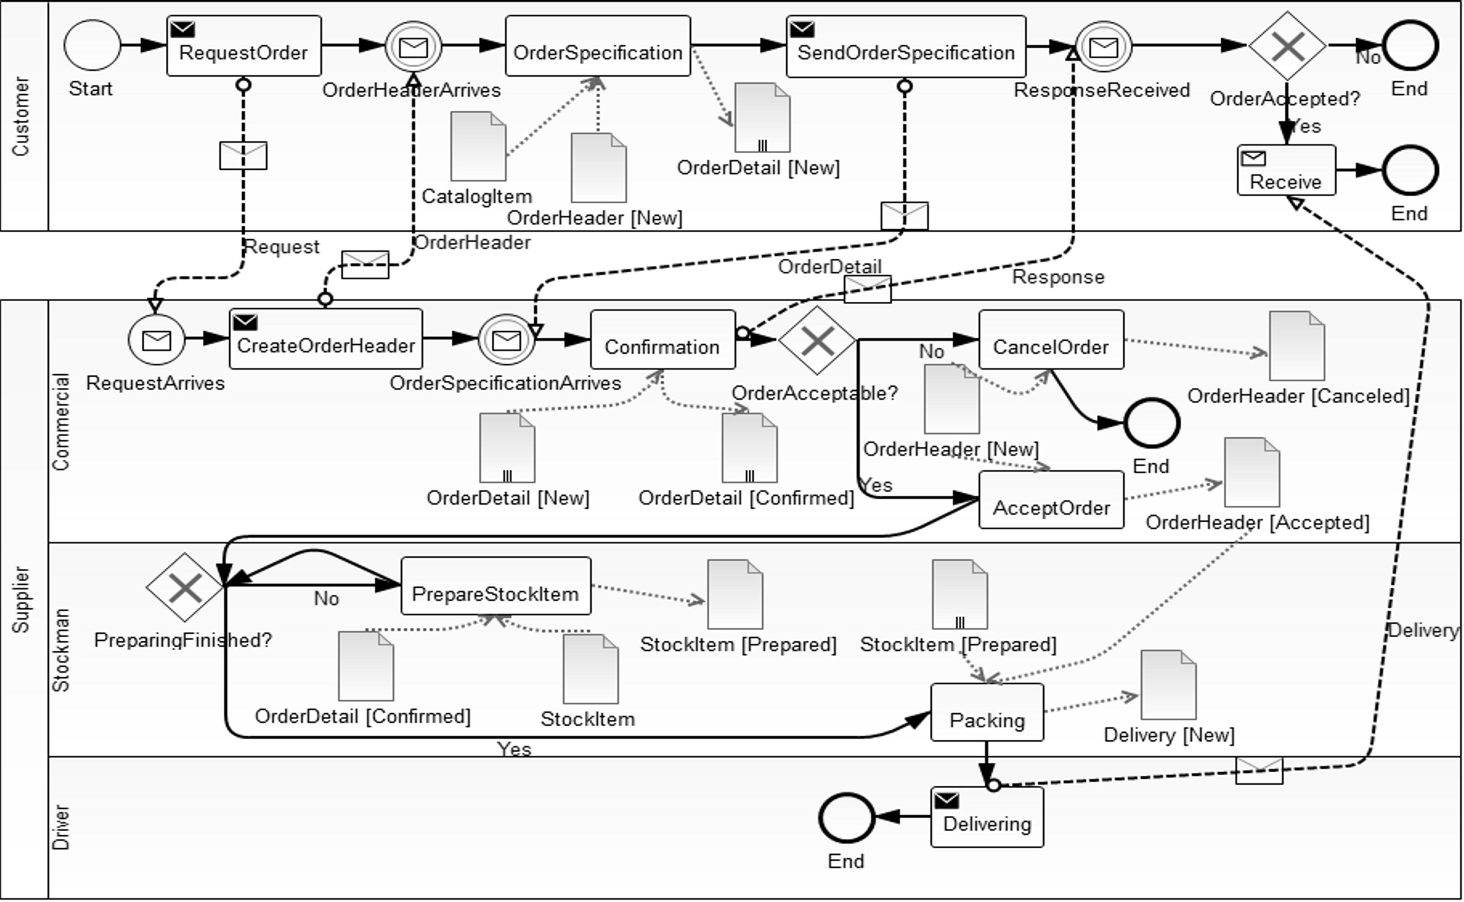
Order processing (1/2)
Source model

Slide 4
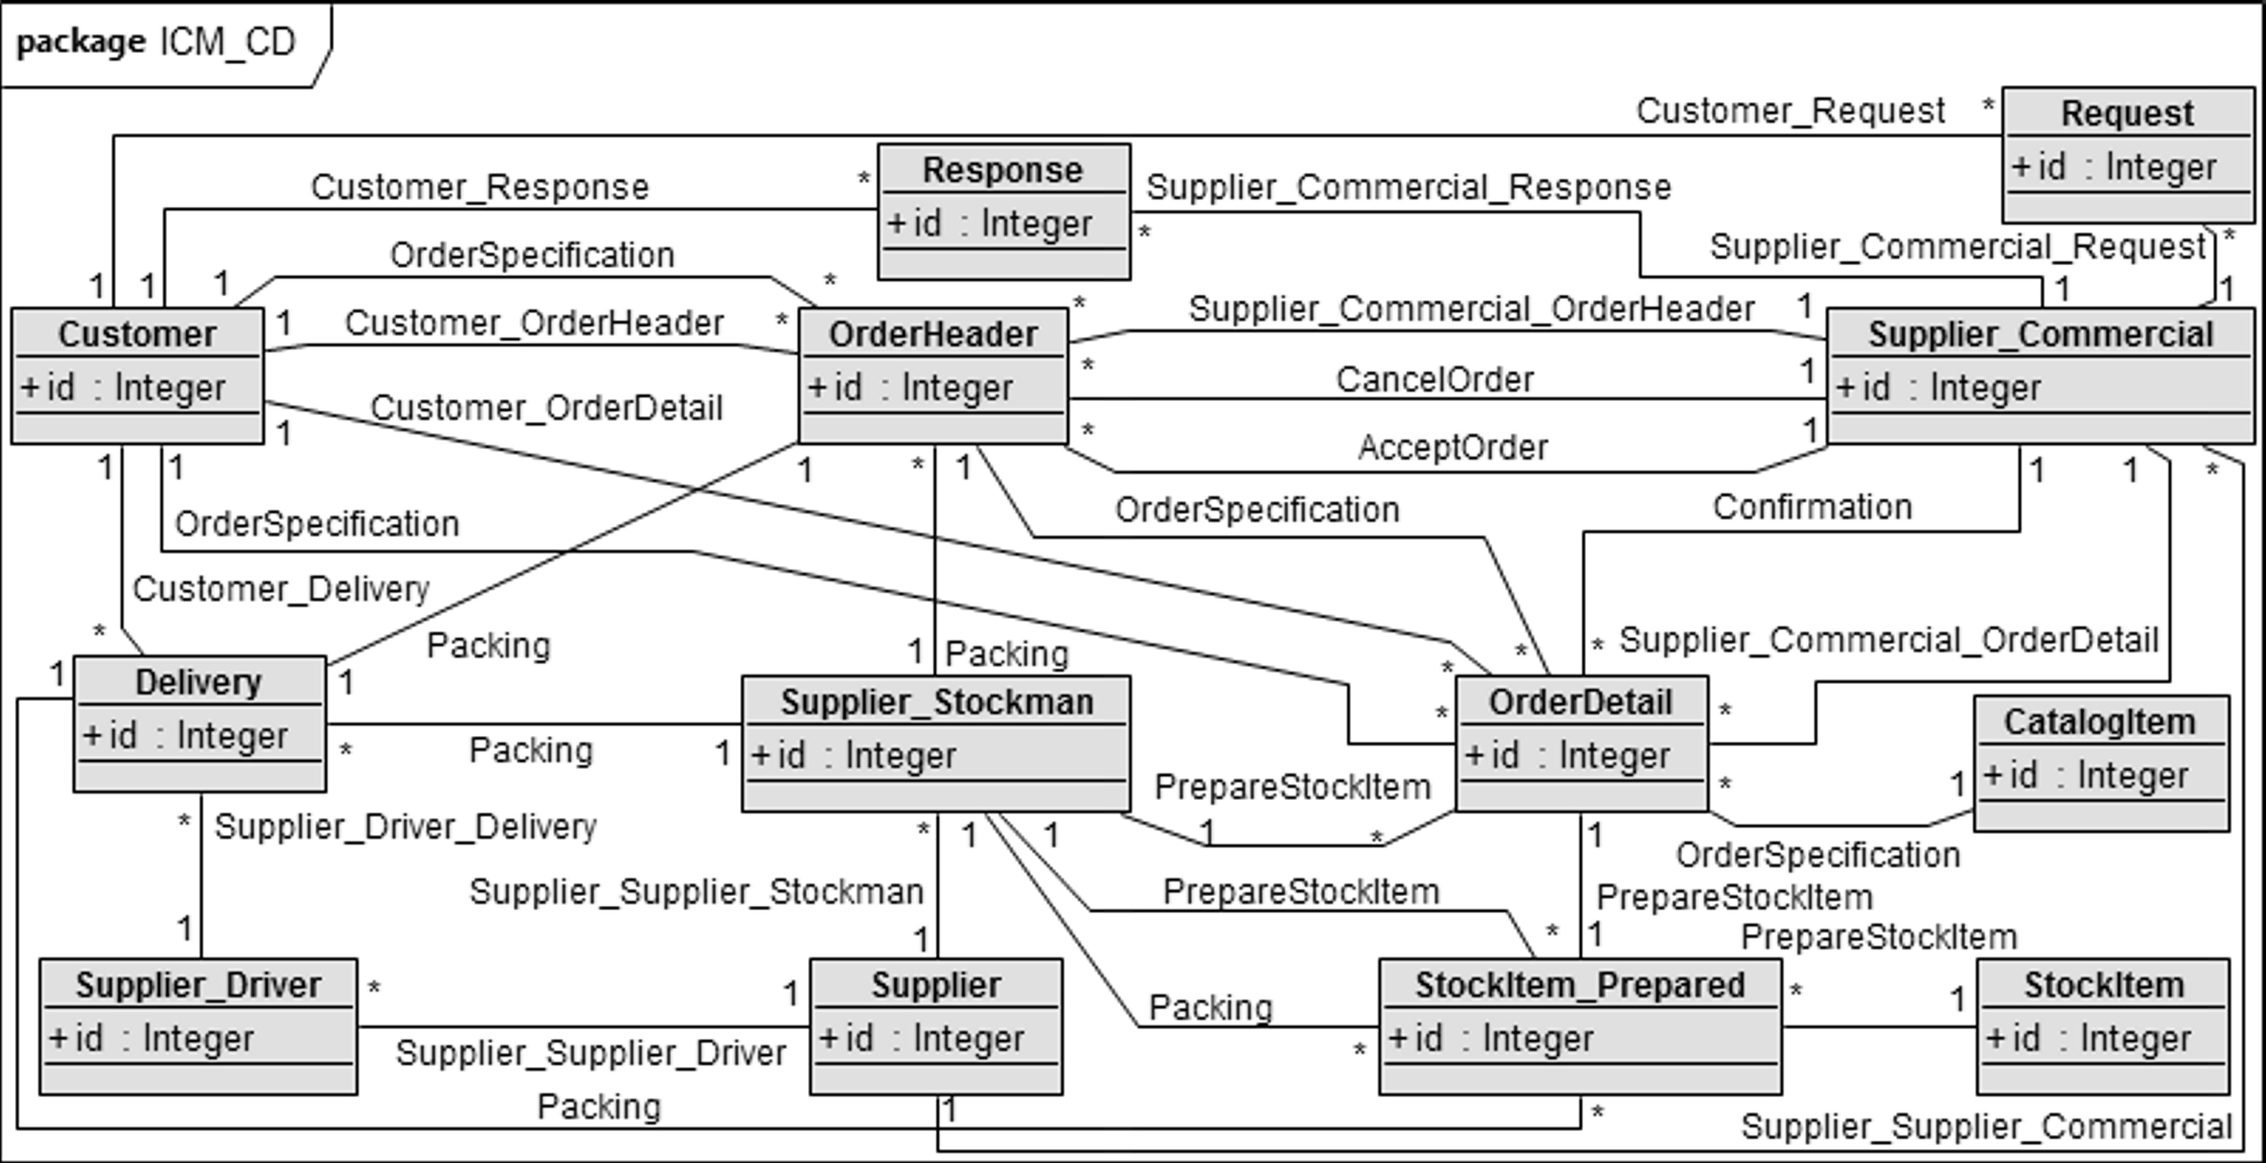
Order processing (2/2)
Automatically generated CDM
Concepts | Metrics & Measures
 | N_{generated} | N_{correct} | N_{incorrect} | N_{sur plus} | N_{sur minus} | Recall [%] | Precision [%]
Classes | 13 | 13 | 0 | 0 | 0 | 100 | 100
Associations | 29 | 28 | 1 | 3 | 1 | 97 | 97

Slide 5
First experiment
First assignment was to create CDM based on given collaborative BPM representing Order processing
8 students participated in this experiment, 6 models were considered for evaluation
All students had the same source model
Time was limited to 90 minutes
Result of initial quantitative analysis of automatically generated CDM
Comparison of automatically generated and manually designed CDM
Concepts | Recall [%] | Precision [%]
Classes | 100 | 100
Associations | 97 | 97
Concepts | Recall [%] | Precision [%]
Classes | 96.43 | 100.00
Associations | 88.35 | 92.78

Slide 6
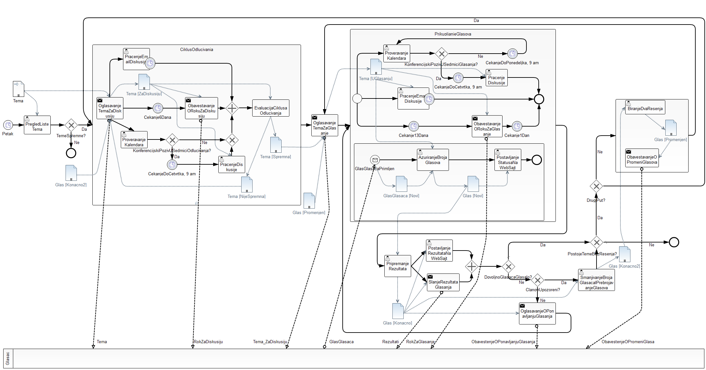
E-mail voting (1/2)
Source model

Slide 7
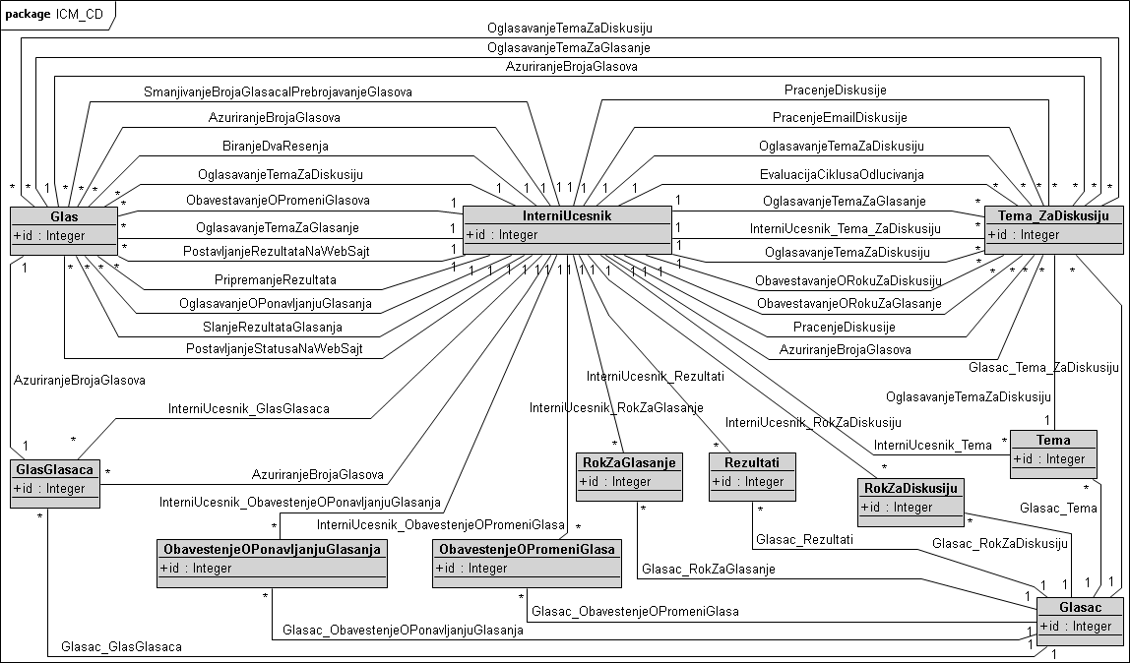
E-mail voting (2/2)
Automatically generated CDM
Concepts | Metrics & Measures
 | N_{generated} | N_{correct} | N_{incorrect} | N_{sur plus} | N_{sur minus} | Recall [%] | Precision [%]
Classes | 11 | 11 | 0 | 0 | 0 | 100 | 100
Associations | 43 | 37 | 6 | 2 | 1 | 97 | 86

Slide 8
Second experiment
In second experiment students had to create CDM based on given collaborative BPM representing E-mail voting (process model from BPMN specification)
14 students participated in this experiment, 6 models were considered for evaluation
All students had the same source model
“unlimited” time
Result of initial quantitative analysis of automatically generated CDM
Comparison of automatically generated and manually designed CDM
Concepts | Recall [%] | Precision [%]
Classes | 100 | 100
Associations | 97 | 86
Concepts | Recall [%] | Precision [%]
Classes | 95.56 | 100.00
Associations | 83.54 | 77.76

Slide 9
Third experiment
Assignment was to evaluate given conceptual database model that is automatically generated based on collaborative BPM E-mail voting
13 students participated in this experiment, 6 models were considered for evaluation
All students had the same source model
Time was limited to 60 minutes
Result of initial quantitative analysis of automatically generated CDM
Results obtained in EXP: #3
Concepts | Recall [%] | Precision [%]
Classes | 100 | 100
Associations | 97 | 86
Concepts | Recall [%] | Precision [%]
Classes | 94.45 | 100.00
Associations | 87.47 | 89.98

Slide 10
Fourth experiment (1/3)
In this experiment students had to create collaborative BPM illustrating real business process model
They also had to create CDM using collaborative BPM as a source model
15 students participated in this experiment, 7 models were considered for evaluation
All students had different source model
“unlimited” time

Slide 11
Fourth experiment (2/3)
Classes
* in manually designed CDM there are classes that couldn’t be generated based on just one collaborative BPM because corresponding objects don’t exist on source model, but we presume that some of missing classes could be generated based on collection of collaborative BPM as source models
Models | N_{manual} | Metrics & Measures
 |  | N_{generated} | N_{correct} | N_{incorrect} | N_{sur plus} | N_{sur minus}* | Recall [%] | Precision [%]
Insurance | 11 | 11 | 11 | 0 | 0 | 0 | 100.00 | 100.00
Health | 10 | 10 | 10 | 0 | 0 | 0 | 100.00 | 100.00
Nobel prize – BPMN spec. | 10 | 10 | 10 | 0 | 0 | 0 | 100.00 | 100.00
Job hiring | 13 | 11 | 11 | 0 | 0 | 0 | 100.00 | 100.00
Scientific conference | 12 | 10 | 10 | 0 | 0 | 0 | 100.00 | 100.00
Delivery | 13 | 12 | 12 | 0 | 0 | 1 | 93.33 | 100.00
Book store | 17 | 14 | 14 | 0 | 0 | 1 | 93.33 | 100.00
MEAN: |  |  |  |  |  |  | 98.09 | 100.00

Slide 12
Fourth experiment (3/3)
Associations
There are more associations automatically generated than manually designed
Models | N_{manual} | Metrics & Measures
 |  | N_{generated} | N_{correct} | N_{incorrect} | N_{sur plus} | N_{sur minus} | Recall [%] | Precision [%]
Insurance | 29 | 37 | 23 | 3 | 11 | 1 | 95.83 | 88.46
Health | 23 | 29 | 22 | 6 | 1 | 1 | 95.65 | 78.57
Nobel prize – BPMN spec. | 24 | 31 | 24 | 3 | 4 | 1 | 96.00 | 88.89
Job hiring | 33 | 37 | 28 | 3 | 6 | 3 | 90.32 | 90.32
Scientific conference | 25 | 21 | 14 | 5 | 2 | 3 | 82.35 | 73.68
Delivery | 36 | 38 | 32 | 2 | 4 | 3 | 91.43 | 94.12
Book store | 39 | 42 | 32 | 5 | 5 | 3 | 91.43 | 86.49
MEAN: |  |  |  |  |  |  | 91.86 | 85.79

Slide 13
Summary
 | Classes |  | Association
Experiments | Recall [%] | Precision [%] | Recall [%] | Precision [%]
Create CDM based on Order processing BPM | 96.43 | 100.00 | 88.35 | 92.78
Create CDM based on E-mail voting BPM | 95.56 | 100.00 | 83.54 | 77.76
Evaluate automatically generated CDM for E-mail voting BPM | 94.45 | 100.00 | 87.47 | 89.98
Create CDM based on own BPM | 98.09 | 100.00 | 91.86 | 85.79
MEAN: | 96.13 | 100.00 | 87.81 | 86.58

Slide 14
Difficulties
Teacher’s perspective
Poor knowledge of conceptual database design
Students have no previous knowledge of BPMN
Students have little experience in modeling
Lack of interest for project assignments
Student’s perspective
BPMN is very complex so it requires significant training and practice in both reading and creating the diagrams
Problems with Topcased - it’s not possible to draw some elements directly to diagram
Designing good collaborative BPM is very challenging
Too many assignments during the semester (including other courses)

Slide 15
Conclusion
These experiments have confirmed that the generator is able to generate a very high percentage of the target CDM with a very high precision
Generator can be used to create initial CDM that can be adapted according to the specific needs
In the future we plan:
to use this experience to improve the generator, as well as the OOD&P course,
to improve and repeat the experiments with the next generation of undergraduate and graduate students

Slide 16
15th Workshop “Software Engineering Education and Reverse Engineering”
Bohinj, 24 - 29 August 2015.
D. Banjac, D. Brdjanin, G. Banjac, S. Maric
University of Banja Luka, Bosnia & Herzegovina
Experience with student projects:
Conceptual database design based on BPMN
Thank You!

